Slide 1
Problem solving with standard form
Standard form

Slide 2
How our teaching resources are designed for the classroom

Slide 3
I can use my knowledge of standard form to solve problems.

Slide 4
Standard form is when a number is written in the form A × 10^{n}, (where 1 ≤ A < 10 and n is an integer).
The associative law states that a repeated application of the operation produces the same result regardless of how pairs of values are grouped. We can group using brackets.
Examples
Non examples
2.4 × 100 =
(48 ÷ 6) ÷ 2 =
4
7 + 10
24 ÷ 6
2.4 × 10 × 10
3 + (4 + 10) =
(3 + 4) + 10
48 ÷ (6 ÷ 2) =
16
48 ÷ 3

Slide 5

Problem solving with standard form
Not quite standard form numbers
Using standard form in problems

Slide 6
Not quite standard form numbers
When numbers are in the form
A × 10^{n}
where 1 ≤ A < 10 and n is an integer.
We know that they are in standard form.
For example, which of the following are not in standard form?
67 × 10¹¹ 0.78 × 10¹¹ 6.2 × 10¹¹ 149 × 10¹²
This is because the A number is not in between 1 and 10, including 1 and not including 10.

Slide 7
Not quite standard form numbers
We can change these numbers into standard form using our knowledge of powers of 10.
67 × 10¹¹ = 67 × 10 × 10 × 10 × 10 × 10 × 10 × 10 × 10 × 10 × 10 × 10
= 6 700 000 000 000
= 6.7 × 10¹²
However, this takes a long time, so we can use the associative law to help.

Slide 8
Not quite standard form numbers
67 × 10¹¹
We need to convert 67 into a number which satisfies
1 ≤ A < 10
6.7 × 10
× 10¹¹
6.7 × 10¹²
Using the associative law allows us to quickly write a number which is not quite in standard form, into standard form efficiently.

Slide 9

Not quite standard form numbers
Write the following in standard form.
a)
b)
Write the following in standard form.
a)
b)
78 × 10²³
960 × 10⁹
× 10²³
7.8 × 10
9.6 × 10 × 10
× 10⁹
7.8 × 10²⁴
9.6 × 10¹¹
2390 × 10⁴
19.01 × 10
2.39 × 10 × 10 × 10
× 10⁴
× 10
1.901 × 10
2.39 × 10⁷
1.901 × 10²

Slide 10
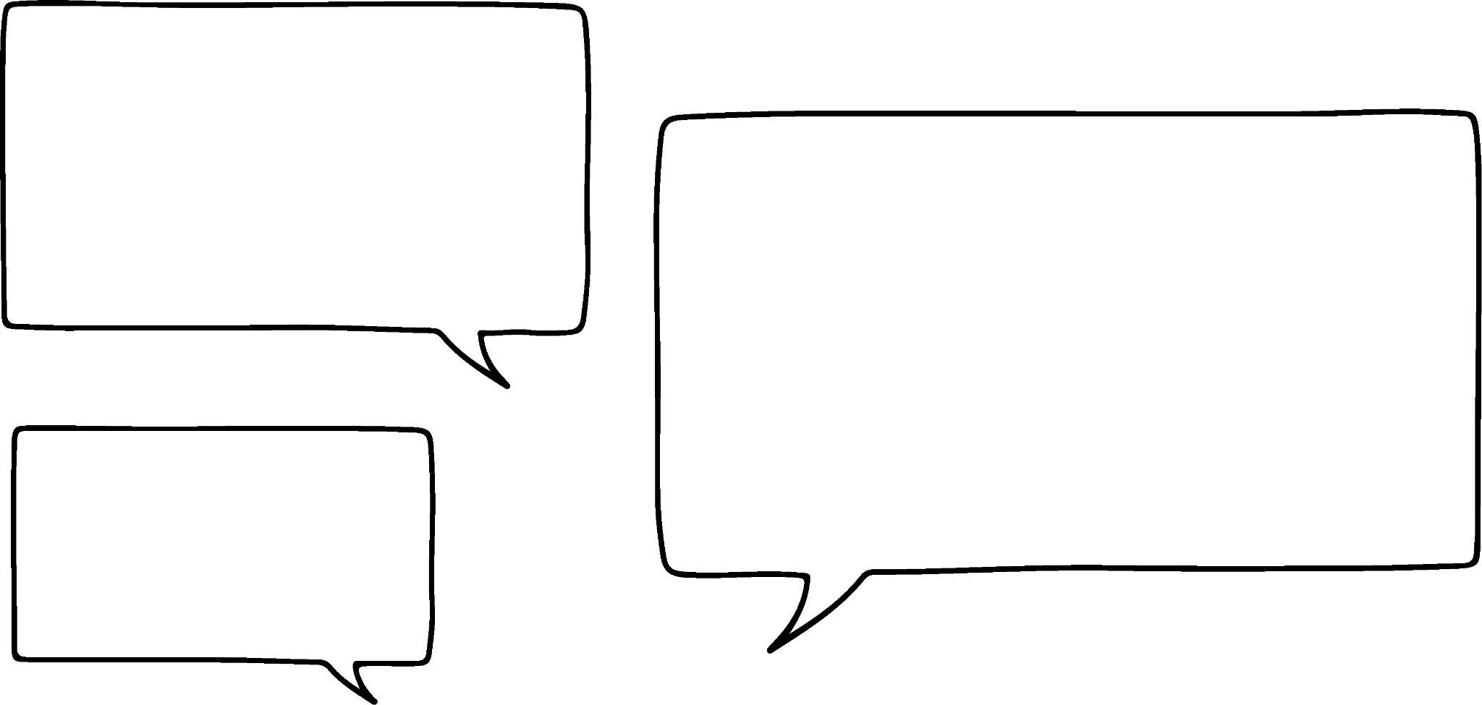


Not quite standard form numbers
Does it also apply with a negative exponent?
Good question. Let’s find out.
9800 × 10⁻⁸
Lucas
Sam
Before Lucas and Sam investigate, what do you think?
Have a look at this question and see, if you continue to add to the exponent when A is too large and there is a negative exponent.

Slide 11
Not quite standard form numbers
We still need to convert 9800 into a number which satisfies
1 ≤ A < 10 and uses powers of 10
9800 × 10⁻⁸
Lucas
Sam

Slide 12

Not quite standard form numbers
10 x
equals 1, so we can simplify the calculation
9800 × 10⁻⁸
9.8 × 10 × 10 × 10
× × × × × × × ×
Lucas
9.8 × 1 × 1 × 1 × × × × ×
Sam
9.8 × 10⁻⁵

Slide 13

Not quite standard form numbers
So I am still adding when the number of A is too big!
The exponent of (−8) when combined with the 3 multiplications of 10 from 9800 gives the new exponent (−5)
9800 × 10⁻⁸
9.8 × 10 × 10 × 10
× × × × × × × ×
Lucas
Sam
9.8 × 1 × 1 × 1 × × × × ×
9.8 × 10⁻⁵

Slide 14
Not quite standard form numbers
Convert the following into standard form:
278 × 10⁻⁵
2900 × 10⁻¹¹
23 × 10¹⁵
3049 × 10⁹
30 400 × 10⁻²
300 000 × 10⁻¹
= 2.78 × 10⁻³
= 2.9 × 10⁻⁸
= 2.3 × 10¹⁶
= 3.049 × 10¹²
= 3.04 × 10²
= 3 × 10⁴

Slide 15
Not quite standard form numbers
What happens when the starting number cannot be made into multiplications of 10? For example
0.87 × 10⁵ ?
We continue to use the associative law, but take a look what happens.
Lucas
Sam

Slide 16
Not quite standard form numbers
Excellent! Because of this we have one less multiplication of 10, so we we subtract 1 from the exponent.
0.87 × 10⁵
8.7 ×
× 10⁵
8.7 × × 10 × 10 × 10 × 10 × 10
8.7 × 1 × 10 × 10 × 10 × 10
Lucas
Sam
8.7 × 10⁴

Slide 17
Not quite standard form numbers
Which of the following are correct?
2.8 × × 10 × 10 × 10 × 10 × 10
0.28 × 10⁵ = 2.8 × 10⁴
3.4 × × × ×10×10×10×10×10×10×10
0.0034 × 10⁷ = 3.4 × 10⁴
9 × × × × × × × ×10×10×10
0.000 000 9 × 10³ = 9 × 10⁻⁴
4 × × 10 × 10
0.4 × 10² = 4 × 10

Slide 18
Not quite standard form numbers
Does it also apply with a negative exponent?
Good question. Let’s find out.
0.075 × 10⁻⁸
Lucas
Sam
Before Lucas and Sam investigate, what do you think?
Have a look at this question and see, if you continue to subtract from the exponent when A is too small and there is a negative exponent.

Slide 19
Not quite standard form numbers
Now we can count the number of as this will be the negative exponent of 10.
0.075 × 10⁻⁸
7.5 × ×
× × × × × × × ×
Lucas
Sam
7.5 × 10⁻¹⁰

Slide 20
Not quite standard form numbers
Which of the following are correct? If incorrect, write the correct answer
0.28 × 10⁻² = 2.8 × 10⁻³
0.0034 × 10⁻⁵ = 3.4 × 10⁻⁸
0.0034 × 10⁻⁵ = 3.4 × 10⁻²
0.000 000 9 × 10⁻²³ = 9 × 10⁻³⁰
0.000 000 9 × 10⁻²³ = 9 × 10⁻³¹
0.4 × 10¹ = 4 × 10⁰
0.4 × 10¹ = 4 × 10

Slide 21
Not quite standard form numbers
Write the following in correct standard form:
398 × 10³⁴
9000 × 10²⁴
340 × 10⁹
89 000 × 10¹⁸
42 × 10⁻⁵
490 000 × 10⁻¹²
99 × 10⁻²

Slide 22
Not quite standard form numbers
2) Write the following in correct standard form:
0.034 × 10³⁹
0.0056 × 10²³
0.000 032 × 10⁹
0.45 × 10⁵
0.583 × 10⁻²
0.003 53 × 10⁻³
0.1 × 10¹

Slide 23
Not quite standard form numbers
3) Write the following in correct standard form:
3590 × 10⁹
0.003 59 × 10⁹
35.9 × 10⁻⁹
0.359 × 10⁻⁹
359 × 10⁻²
359 × 10²
35.9 × 10⁻²

Slide 24
Not quite standard form numbers
Write the following in correct standard form:
398 × 10³⁴
9000 × 10²⁴
340 × 10⁹
89 000 × 10¹⁸
42 × 10⁻⁵
490 000 × 10⁻¹²
99 × 10⁻²
= 3.98 × 10³⁶
= 9 × 10²⁷
= 3.4 × 10¹¹
= 8.9 × 10²²
= 4.2 × 10⁻⁴
= 4.9 × 10⁻⁷
= 9.9 × 10⁻¹

Slide 25
Not quite standard form numbers
2) Write the following in correct standard form:
0.034 × 10³⁹
0.0056 × 10²³
0.000 032 × 10⁹
0.45 × 10⁵
0.583 × 10⁻²
0.003 53 × 10⁻³
0.1 × 10¹
= 3.4 × 10³⁷
= 5.6 × 10²⁰
= 3.2 × 10⁴
= 4.5 × 10⁴
= 5.83 × 10^{–3}
= 3.53 × 10⁻⁶
= 1 × 10⁰

Slide 26
Not quite standard form numbers
3) Write the following in correct standard form:
3590 × 10⁹
0.003 59 × 10⁹
35.9 × 10⁻⁹
0.359 × 10⁻⁹
359 × 10⁻²
359 × 10²
35.9 × 10⁻²
= 3.59 × 10¹²
= 3.59 × 10⁶
= 3.59 × 10⁻⁸
= 3.59 × 10⁻¹⁰
= 3.59 × 10⁰
= 3.59 × 10⁴
= 3.59 × 10⁻¹

Slide 27
Problem solving with standard form
Not quite standard form numbers
Using standard form in problems

Slide 28
Using standard form in problems
We use many prefixes associated with standard form every day. For example, kilo means 10³.
Can you match the name of the number with the corresponding powers of 10?
Million
Billion
Mega
Tera
Micro
Giga
10⁹
10⁶
10¹²
10⁻⁶

Slide 29
Using standard form in problems
Can you think of some real life examples, where you have heard or used this prefixes?
Million
Example: 1 million pounds
Example: Population on Earth (2024) is approximately
8 billion people
Billion
Mega
Example: A USB flash drive has a memory of 64 megabytes
Tera
Example: An external hard drive has 1 terabyte of memory
Micro
Example: Microchips are found in most electronic devices

Slide 30
Using standard form in problems
Why do we say
“64 megabytes”
instead of 64 × 10⁶ bytes or 6.4 × 10⁷ bytes?
It just sounds better
Lucas
Sam
Although, standard form is not sometimes used, the convention is to use the prefix and from there we can use it to convert to standard form and use where needed.

Slide 31
Using standard form in problems
Work out how many bytes there are in the following, give your answer in standard form:
a) 128 GB
b) 30 TB (1 terabyte)
128 × 10⁹ = 1.28 × 10 × 10 × 10⁹
= 1.28 × 10¹¹ bytes
30 × 10¹² = 3 × 10 × 10¹²
= 3 × 10¹³ bytes

Slide 32
Using standard form in problems
Using a calculator, how many days is 1 million seconds?
1 million = 1 × 10⁶ = 1 000 000s
1 000 000 ÷ 60 = 16666.6 minutes
16666.6 ÷ 60 = 277.7 hours
277.7 ÷ 24 = 11.57 (2 d.p.) days

Slide 33
Using standard form in problems
Sometimes, some things are so big or small, we can’t visualise them. For example:
The radius of Earth is approximately 6 000 000 m.
The radius of Jupiter is approximately 60 000 000 m.
How many times bigger is Jupiter than Earth?
Earth’s radius ≈ 6 × 10⁶ m
Jupiter’s radius ≈ 6 × 10⁷ m
When in standard form it is easy to see.

Slide 34
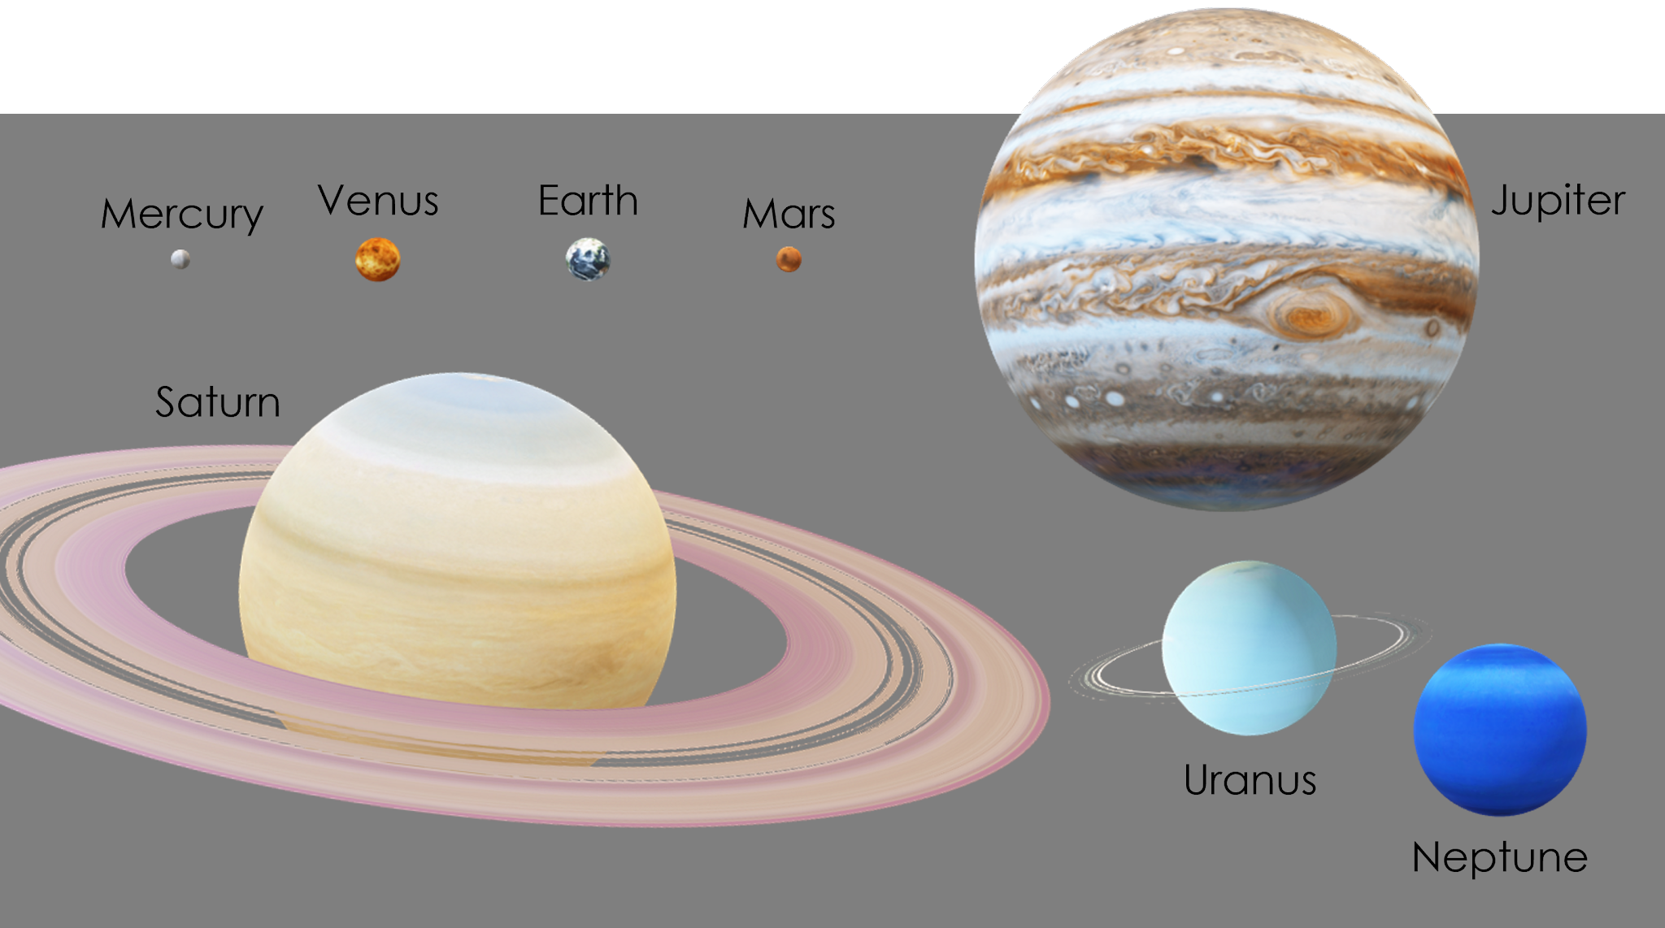
Using standard form in problems
Jupiter’s radius is 10 times bigger than Earth!
These numbers are so big, it can be hard to imagine.

Slide 35
Using standard form in problems
1) How many years are 1 billion seconds?
Use a calculator and use 365 days as a standard year.
2) Flash drives come in 16MB, 64MB and 128MB. A video was made and has 21 700 000 bytes.
Given that 1 × 10⁶ is 1 MB (megabyte).
What is the minimum flash drive needed to put this film on?

Slide 36
Using standard form in problems
3) The radius of Mercury is approximately 2 500 km.
The radius of Neptune is approximately 25 000 000 m.
How many times bigger is Neptune than Mercury?

Slide 37
Using standard form in problems
Planet | ≈ Radius
Mercury | 2 500 km
Venus | 6 000 km
Earth | 6 000 km
Mars | 3 000 km
Jupiter | 71 000 km
Saturn | 60 000 km
Uranus | 25 000 km
Neptune | 25 000 km
4) Here are some approximations of the radii of planets.
Write any two of your own questions, including the use of standard form.

Slide 38
Using standard form in problems
1) How many years are 1 billion seconds?
Use a calculator and use 365 days as a standard year.
1 billion = 1 × 10⁹ = 1 000 000 000 seconds
1 000 000 000 ÷ 60 = 16 666 666.7 (1 d.p.) minutes
16 666 666.7 ÷ 60 = 277 777.8 (1 d.p.) hours
277 777.8 ÷ 24 = 11 574.1 (1 d.p.) days
11 574.1 ÷ 365 = 31.7 (1 d.p.) years

Slide 39
Using standard form in problems
2) Flash drives come in 16 MB, 64 MB and 128 MB. A video was made and has 21 700 000 bytes.
Given that 1 × 10⁶ is 1 MB (megabyte).
What is the minimum flash drive needed to put this film on?
21 700 000 = 2.17 × 10⁷
This is the same as 21.7 × 10⁶
Given we know × 10⁶ is the same as Mega we can say that 2.17 × 10⁷ = 21.7MB
The minimum is a 64MB flash drive.

Slide 40
Using standard form in problems
3) The radius of Mercury is approximately 2 500 km.
The radius of Neptune is approximately 25 000 000 m.
How many times bigger is Neptune’s radius than Mercury’s?
Mercury’s radius ≈ 2 500 km = 2 500 000 m = 2.5 × 10⁶ m
Neptune’s radius ≈ 2.5 × 10⁷ m
Neptune’s radius is 10 times bigger than Mercury’s radius.

Slide 41
Using standard form in problems
Planet | ≈ Radius
Mercury | 2 500 km
Venus | 6 000 km
Earth | 6 000 km
Mars | 3 000 km
Jupiter | 71 000 km
Saturn | 60 000 km
Uranus | 25 000 km
Neptune | 25 000 km
4) Here are some approximations of the radii of planets.
Write any two of your own questions, including the use of standard form.
Write all of these radii in m using standard form.
Put the planets in ascending order, using standard form.

Slide 42
Problem solving with standard form
When a number is not quite written in standard form, we can use the associative law to write it in standard form.
For example, 960 × 10⁹ = 9.6 × 10¹¹
0.0034 × 10⁷ = 3.4 × 10⁴
Problems involving real life applications of extremely large numbers or small numbers can be solved using standard form.

Slide 43

© Oak National Academy 2024.
Produced in partnership with Mathematics in Education and Industry.
Licensed on the Open Government Licence v3.0, except where otherwise stated. See Oak terms and conditions.

